Slide 1
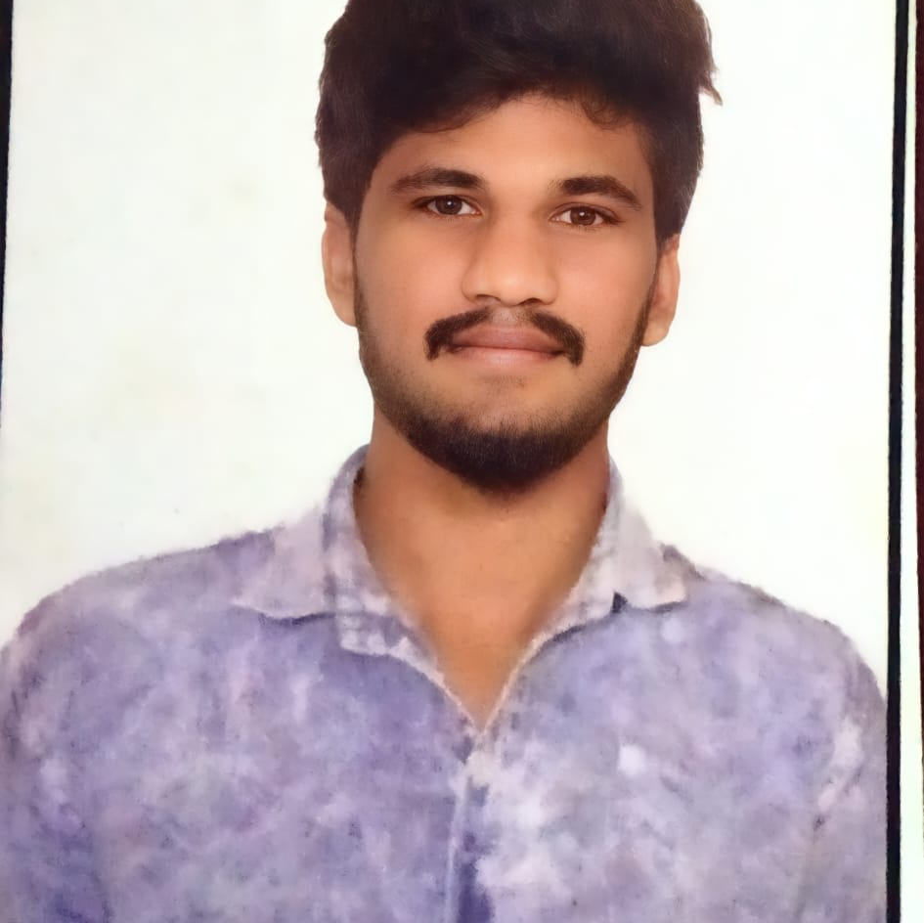


MAHESH PASAPU
Bachelor of Engineering
YEAR:2018-2021
Analyst/Software Engineer
Skills
Bangalore
JAVA | Basics of java, Core Java,, Oops concepts
UI Framework-React | Fundamentals components ,Java Script, Event Handling in React , Working with HTTP in React.
React | Components, Services, Modules, Routing, Forms & Validation, Testing using Junit & Mockito
Database | MongoDB,
UI Tech | HTML 5 & CSS 3,JavaScript
Tools | Spring Tool ,Visual Studio 2019, Visual Studio code, Swagger, Postman.
Add On skills | Communications, Team management. Peer learning
mahesh.pasapu@capgemini.com
+91 6303756423
A4
Proficient in JAVA and OOPs concepts.
Hands on experience in creating Web Application with Spring Boot and React.
Practical Understanding of Mongo Database
Hands on experience in developing web pages using HTML5, CSS3, Object Oriented Programming, JSON, XML. Good understanding of Document Object Model (DOM) and DOM Functions.
Practical understanding of rendering SPRINGMVC, REST API.
Proficient React developer with working knowledge on React.
Implemented Web API and React in case study and up skilling this knowledge continuously.
HOTEL MANAGEMENT SYSTEM
Working on end to end case study Hotel Management System along with authentication , Eureka, Swagger, Postman and React used for user interface.
Java Full Stack Developer in Degreed Platform
Completed this course with optimal Knowledge of Spring Framework ,Web API , RESTful services , Components.

